Slide 1
Shell Bootcamp 2024
SAP-ERP TECHNICAL & FUNCTIONAL 3 Reflections for Week 4 (16-Sep-2024 – 20-Sep-2024)
Hitesh
Date : 20-Sep-2024

Slide 2

About Me
A successful team is a group of many hands but of one mind.

Slide 3
Shell Bootcamp 2024
SAP-ERP TECHNICAL Sessions 3 Reflections for Week 4 (16-Sep-2024 – 18-Sep-2024)

Slide 4

My learnings from this week!

Slide 5
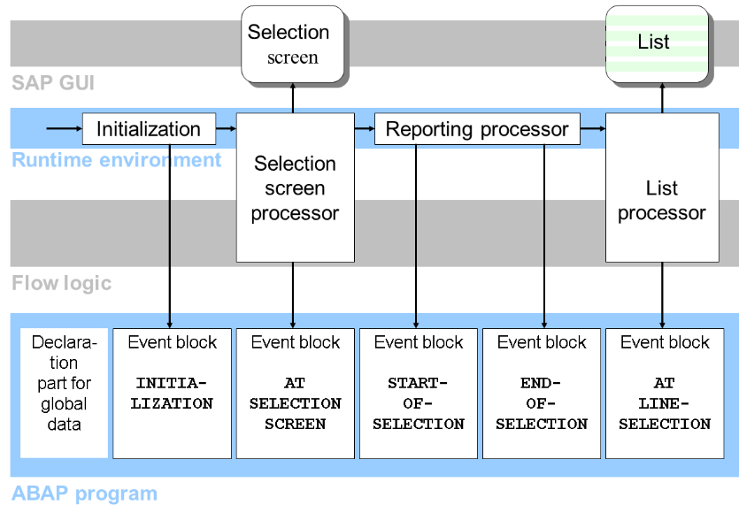
Learning 1 | My takeaways
ABAP Reports
Key Learning: ABAP reports come in three types: Classic, Interactive, and ALV (ABAP List Viewer). Classic provides basic output, Interactive allows user-driven drill-downs, and ALV offers advanced functionalities like sorting, filtering, and data export.
Key Takeaway: ALV reports are the most powerful, enabling users to customize layouts, sort, filter, and export data, making them ideal for complex reporting needs.
How I see it implemented in the Energy Sector: ALV reports can help track energy consumption and performance by generating customizable reports, while Interactive reports can be used for detailed asset management. Classic reports can serve simple data retrieval needs.

Slide 6
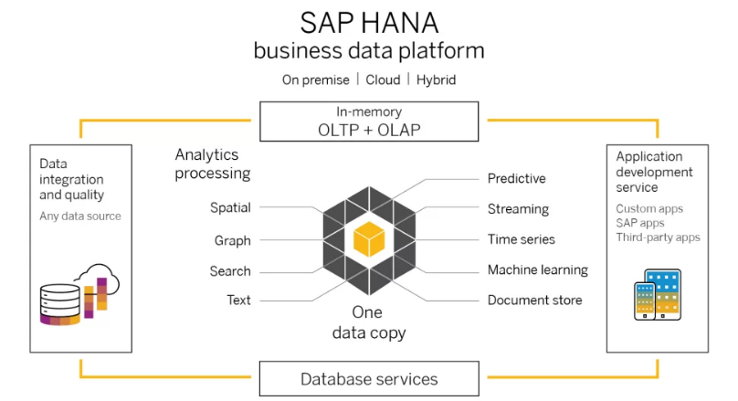
Learning 2 | My takeaways
SAP HANA
Key Learning: SAP HANA is an in-memory database that allows for real-time data processing and analytics. It integrates with advanced features such as predictive analysis, machine learning, and big data capabilities.
Key Takeaway: The speed and agility of SAP HANA enable real-time decision-making by processing large volumes of data almost instantly, providing a competitive edge in business analytics and performance.
How I see it implemented in the Energy Sector: SAP HANA can transform energy management by enabling real-time monitoring of energy production, distribution, and consumption. It allows energy companies to predict demand spikes, optimize asset maintenance, and analyze environmental impacts in real-time, improving overall efficiency and sustainability.

Slide 7
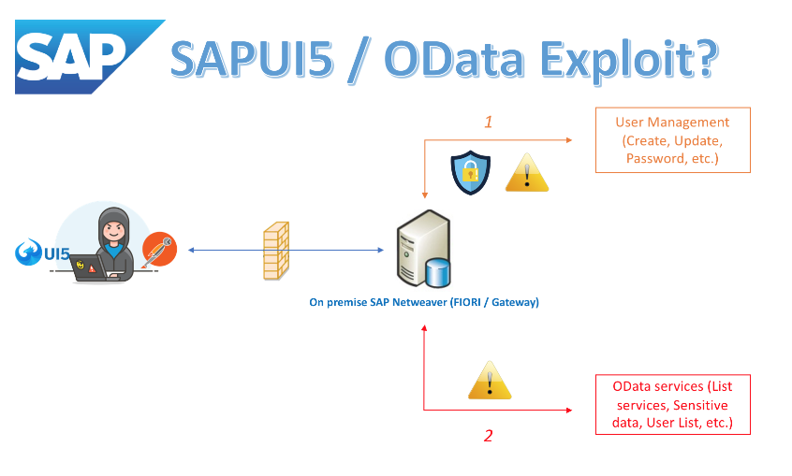
Learning 3 | My takeaways
SAP Fiori/OData/BTP
Key Learning: SAP Fiori is a user experience (UX) design framework that simplifies SAP applications. OData (Open Data Protocol) allows for the secure exchange of data, and SAP BTP (Business Technology Platform) supports integration, extension, and innovation in cloud environments.
Key Takeaway: SAP Fiori provides a modern, user-friendly interface, while OData enables seamless data sharing. SAP BTP fosters innovation by integrating existing business applications with cloud services and intelligent technologies, allowing for greater scalability and flexibility.
How I see it implemented in the Energy Sector: SAP Fiori can provide intuitive, mobile-friendly interfaces for field workers and managers to access critical data in real-time. OData can support integration between different systems, such as linking operational data with financial records. SAP BTP allows energy companies to adopt new technologies like IoT and AI to optimize energy production, grid management, and predictive maintenance.

Slide 8

Relevance of learnings for my organization

Slide 9

Learning 1 | Relevance for Shell
ABAP Reports
How I feel Shell implements this learning: Shell likely uses ABAP reports to monitor its operations by generating detailed, customized reports on oil production, refining, and supply chain processes. ALV reports, with their flexibility and data export options, help streamline reporting across different teams and regions.
How I feel Shell benefits from this learning: By leveraging the powerful reporting capabilities of ALV, Shell can improve decision-making with real-time, accurate insights into production efficiency, costs, and performance metrics, enhancing overall business agility and operational excellence.

Slide 10

Learning 2 | Relevance for Shell
SAP HANA
How I feel Shell implements this learning: SAP HANA enables Shell to process large volumes of data in real-time, helping the company manage critical data for its global operations. This includes real-time monitoring of oil fields, refining processes, and supply chain management.
How I feel Shell benefits from this learning: With SAP HANA’s in-memory processing and advanced analytics, Shell benefits from quicker insights into operational data, enabling faster response times to market fluctuations, optimized resource allocation, and better forecasting for production and demand.

Slide 11

Learning 3 | Relevance for Shell
SAP Fiori/OData/BTP
How I feel Shell implements this learning: Shell likely adopts SAP Fiori to offer its employees a simplified, user-friendly interface for accessing critical business applications. OData ensures smooth data integration across Shell’s global operations, and SAP BTP helps innovate by connecting systems in the cloud and integrating new technologies like IoT.
How I feel Shell benefits from this learning: By implementing SAP Fiori and BTP, Shell improves employee productivity and efficiency, as data becomes more accessible across devices and departments. BTP enables Shell to rapidly innovate, adopt emerging technologies, and scale its operations while maintaining system efficiency and security.

Slide 12

Challenges in implementing learning

Slide 13

Challenge faced while implementing Learning 1
ABAP Reports
Challenge Faced: One challenge is the complexity of creating and maintaining customized ALV reports that meet the diverse reporting needs of various departments, especially when integrating data from different sources and systems across Shell's global operations.
Plan to Overcome: To address this, Shell could invest in training for ABAP developers, focusing on best practices for modular report development. Implementing a standardized reporting framework across departments can streamline report creation and ensure consistency in data presentation.

Slide 14

Challenge faced while implementing Learning 2
SAP HANA
Challenge Faced: The challenge with SAP HANA is managing the high cost of implementation, especially for scaling HANA across large global operations, and ensuring data security while handling vast amounts of real-time data.
Plan to Overcome: To mitigate costs, Shell could adopt a phased implementation approach, starting with high-priority use cases. Additionally, enhancing cybersecurity measures and establishing a robust data governance framework can ensure the protection of sensitive information while scaling HANA across the organization.

Slide 15

Challenge faced while implementing Learning 3
SAP Fiori/OData/BTP
Challenge Faced: A major challenge is ensuring seamless integration of legacy systems with new SAP Fiori interfaces and BTP solutions, as well as overcoming resistance to change from employees who are used to traditional systems.
Plan to Overcome: To overcome this, Shell could prioritize gradual system integration while providing comprehensive training and support for employees. Engaging key stakeholders early in the process and promoting the user-friendly features of Fiori can help ease the transition and encourage adoption of the new platforms.

Slide 16

Action Plan

Slide 17
My Action Plan for this Week
Actions
Timeline
Status
Review and practice creating ALV reports, focusing on advanced features like sorting, filtering, and exporting data.
Research SAP HANA’s real-time data processing capabilities and how it’s applied in the energy sector.
Explore case studies of SAP HANA implementations in large organizations for operational improvements.
Familiarize myself with SAP Fiori by using demo systems and learning key features.
2 day
1 days
1 day
1 day
Completed
Completed
Completed
Completed

Slide 18

Learning is also Fun!

Slide 19
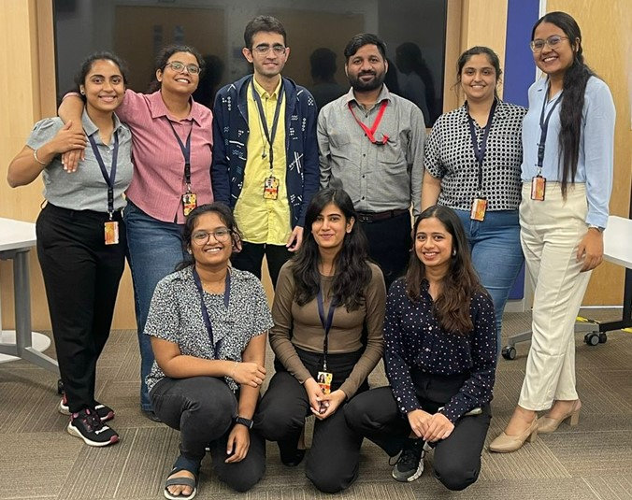
Learning is also Fun!
Activity:
We had interactive jam sessions and engaging story sessions where team members shared insights about their specialties. These sessions gave me a deeper understanding of my colleagues' expertise while building a collaborative learning environment.
A big relief came when we transitioned to hands-on practical sessions after several long days of theory. The practical work allowed us to apply what we had learned, making the experience more dynamic and engaging.
Additional Fun Activities:
After the sessions, we had a team lunch, which turned into a fun pizza party! It was a great opportunity to bond over food and laughter, creating a relaxed and friendly atmosphere that made learning more enjoyable and helped build stronger connections with the team.

Slide 20

Summary
Quick Summary
This week focused on deepening knowledge of ABAP Reports (specifically ALV), SAP HANA, and SAP Fiori/OData/BTP. Each topic was explored for its technical applications and relevance to the energy sector, with particular attention to reporting, real-time data processing, and user experience improvements.
Importance of Topics for Upcoming Week
Understanding ABAP Reports, SAP HANA, and SAP Fiori is essential as they form the backbone of many SAP systems. This technical foundation will support the study of SAP’s functional aspects next week, particularly in terms of how functional modules interact with these technologies.
Connectivity of Topics from Current Week
The focus on ABAP and SAP HANA reports directly links to functional modules, where reporting and data analysis are crucial. Similarly, SAP Fiori’s user-friendly interface will be important when navigating and understanding the functional part of SAP. The knowledge from this week lays a strong groundwork for integrating technical and functional learning in the upcoming week.

Slide 21
Shell Bootcamp 2024
SAP-ERP FUNCTIONAL Sessions 3 Reflections for Week 4 (19-Sep-2024 – 20-Sep-2024)

Slide 22
My learnings from this week!

Slide 23
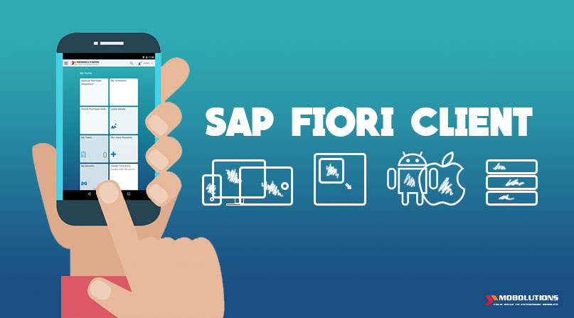
Learning 1 | My takeaways
SAP Fiori User Experience, Tcode-SPRO, User Types
Key Learning: SAP Fiori provides a modern user experience (UX) for SAP software across all lines of business, tasks, and devices. Tcode-SPRO is used to configure and customize SAP applications. SAP also distinguishes between different user types, including dialog users, system users, and communication users.
Key Takeaway: Understanding SAP Fiori's UX enhances user productivity by offering an intuitive interface. Mastering Tcode-SPRO is essential for making configuration changes, and knowing the user types helps with system security and access control.
How I see it implemented in the Energy Sector: In the energy sector, SAP Fiori enables simplified workflows for field operators, maintenance engineers, and back-office teams. Tcode-SPRO is vital for configuring modules that manage resources like materials and finances. Understanding user types helps secure sensitive data, ensuring only authorized personnel can access critical systems.

Slide 24
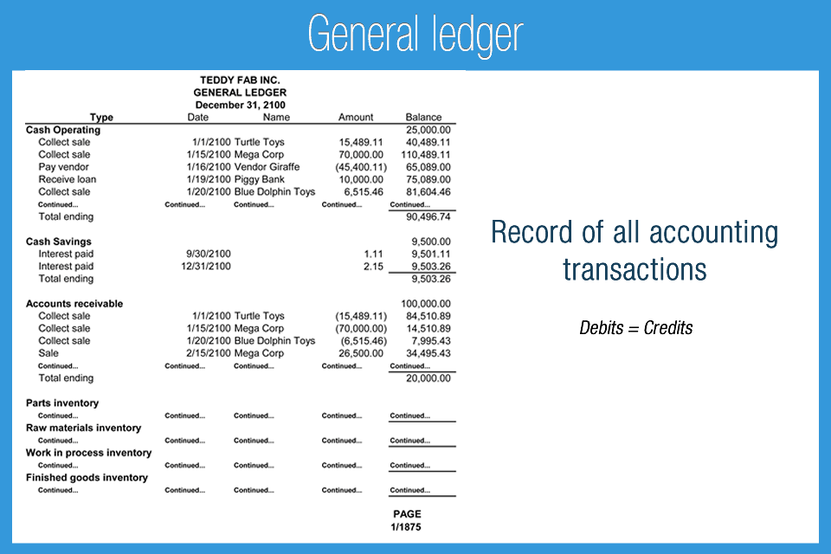
Learning 2 | My takeaways
Creating Vendor Master Table, Customer Master Table, and General Ledger
Key Learning: Vendor master (Tcode: XK01) and customer master (Tcode: XD01) are essential to manage the business partner's information like contact details, payment terms, and account information. The general ledger (Tcode: FS00) records all the financial transactions of the company, serving as the foundation for financial reporting.
Key Takeaway: Accurate creation and management of vendor and customer master tables ensure smooth transactions and strong business relationships. The general ledger acts as the central hub for financial integrity and transparency.
How I see it implemented in the Energy Sector: In the energy sector, vendor and customer master tables ensure efficient supply chain operations, including procurement and billing for energy supply. A properly maintained general ledger is crucial for accurate financial reporting and compliance with industry regulations.

Slide 25
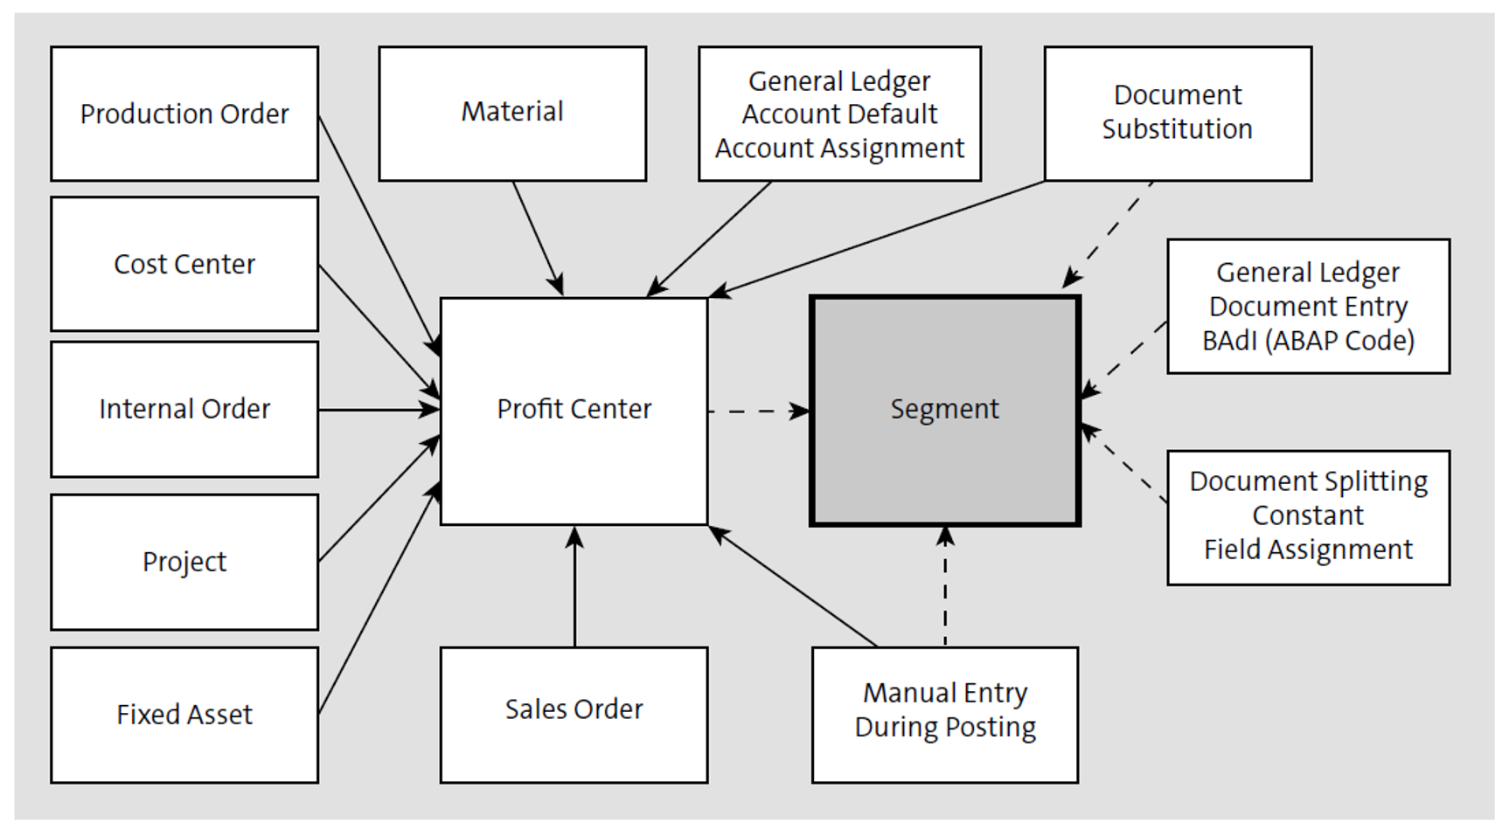
Learning 3 | My takeaways
Segment, Profit Center, and Cost Center Creation
Key Learning: Segment (Tcode: OSEG), Profit Center (Tcode: KE51), and Cost Center (Tcode: KS01) are key organizational units for financial tracking. Segments allow for segmental reporting, profit centers are used to assess business profitability, and cost centers help track expenses.
Key Takeaway: Effective management of segments, profit centers, and cost centers is critical for analyzing financial performance, allocating resources, and making strategic decisions.
How I see it implemented in the Energy Sector: In the energy sector, segments could represent different types of energy (e.g., oil, gas, renewables), profit centers may represent different business units, and cost centers might track maintenance costs for facilities. This structure supports detailed financial analysis and informed decision-making.

Slide 26
Relevance of learnings for my organization

Slide 27

Learning 1 | Relevance for Shell
SAP Fiori User Experience, Tcode-SPRO, User Types
How I feel Shell implements this learning: Shell likely leverages SAP Fiori to streamline user interactions across devices, ensuring field workers and office staff have access to the same system with an intuitive interface. Tcode-SPRO is likely used extensively by the IT team to customize Shell’s SAP system to meet the company's global operational needs. The distinction between user types ensures that the right employees have access to the necessary tools, improving security and operational efficiency.
How I feel Shell benefits from this learning: Shell benefits from SAP Fiori's UX by improving employee productivity and system accessibility, ensuring fast decision-making. With Tcode-SPRO, Shell can tailor the SAP environment to support its complex, global operations. Managing user types ensures data security, reducing risks of unauthorized access to critical systems.

Slide 28
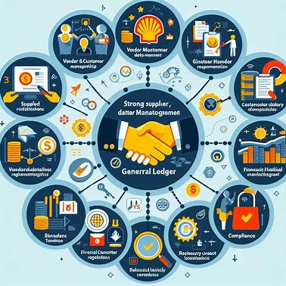
Learning 2 | Relevance for Shell
Creating Vendor Master Table, Customer Master Table, and General Ledger
How I feel Shell implements this learning: Shell likely utilizes the vendor master and customer master tables to manage its vast network of suppliers and clients, from equipment manufacturers to energy purchasers. The general ledger ensures that all financial transactions are meticulously recorded, which is essential for compliance, auditing, and financial analysis.
How I feel Shell benefits from this learning: Having accurate vendor and customer data allows Shell to maintain strong, efficient relationships with both suppliers and customers, which is crucial for supply chain reliability. A well-maintained general ledger supports Shell’s financial transparency and accountability, enabling better financial planning, risk management, and regulatory compliance.

Slide 29
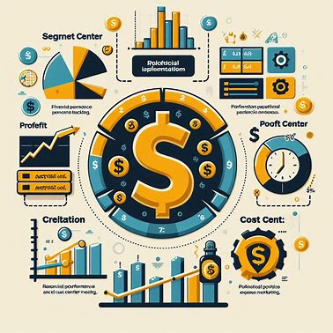
Learning 3 | Relevance for Shell
Segment, Profit Center, and Cost Center Creation
How I feel Shell implements this learning: Shell likely uses segments to track the financial performance of different energy sectors, such as oil, gas, and renewables. Profit centers help Shell assess the profitability of its various divisions, while cost centers enable the company to monitor operational expenses, such as those for oil rig maintenance or refinery operations.
How I feel Shell benefits from this learning: By creating and managing segments, profit centers, and cost centers, Shell can better allocate resources, analyze performance across business units, and optimize cost efficiency. This enables Shell to make strategic decisions, such as whether to invest more in renewable energy or optimize existing oil and gas operations, enhancing overall profitability.

Slide 30
Challenges in implementing learning

Slide 31
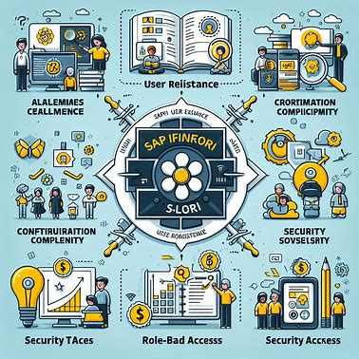
Challenge faced while implementing Learning 1
SAP Fiori User Experience, Tcode-SPRO, User Types
Challenge Faced: Implementing SAP Fiori across all teams and devices may encounter resistance from employees accustomed to the old SAP GUI. Additionally, ensuring proper configuration through Tcode-SPRO for a global organization like Shell can be complex, with a high risk of misconfigurations. Managing user types also requires careful oversight to ensure security without impeding productivity.
Plan to Overcome: To overcome user resistance, provide comprehensive training sessions focusing on the ease and benefits of SAP Fiori’s interface. For configuration challenges, establish a dedicated cross-functional team with clear responsibilities for SPRO changes and regular audits to catch and correct misconfigurations early. For managing user types, implement role-based access with ongoing reviews to keep security robust without restricting necessary access.

Slide 32
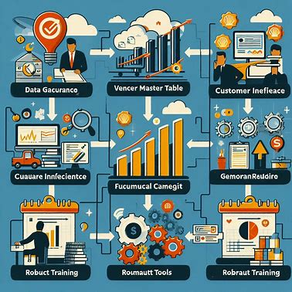
Challenge faced while implementing Learning 2
Creating Vendor Master Table, Customer Master Table, and General Ledger
Challenge Faced: Maintaining accurate and up-to-date vendor and customer information across multiple regions and operations can be challenging. Discrepancies or outdated data can lead to operational inefficiencies. Similarly, ensuring the accuracy of the general ledger, especially in a multinational organization like Shell, is complex due to different currencies, tax laws, and accounting standards.
Plan to Overcome: To ensure data accuracy, implement a strict data governance framework with regular data audits for vendor and customer tables. Use automated tools for data validation and real-time updates. For the general ledger, ensure the finance team is equipped with robust training and tools that automatically handle currency conversions, tax compliance, and cross-border accounting rules.

Slide 33

Challenge faced while implementing Learning 3
Segment, Profit Center, and Cost Center Creation
Challenge Faced: Defining the right segmentation for profit and cost centers in a diverse and global organization like Shell can be difficult. Over-segmentation could lead to complexity in reporting and decision-making, while under-segmentation might limit insights. Managing financial performance across various units and sectors can become cumbersome without precise definitions and clear ownership.
Plan to Overcome: To address this, Shell can start with high-level segmentation and gradually refine it based on business needs and financial performance indicators. Involve cross-functional stakeholders in defining profit and cost centers to ensure they align with strategic goals. Use automation tools for financial reporting to reduce manual errors and enhance visibility across segments, profit centers, and cost centers.

Slide 34
Action Plan

Slide 35
My Action Plan for this Week
Actions
Timeline
Status
Schedule a training session to explore SAP Fiori's user interface and understand its benefits for productivity, as well as collaborate with IT to gain insights into customization using Tcode-SPRO.
Review Shell’s current vendor and customer master tables to understand their structure and data governance policies, followed by practicing Tcodes (XK01, XD01, FS00) in a sandbox environment.
Meet with the finance and operations teams to discuss how Shell defines and manages segments, profit centers, and cost centers, and study the impact of segmentation on financial performance.
Conduct a detailed review of Shell’s general ledger processes to understand how the company manages currency conversions, tax compliance, and multi-region financial reporting.
Training session and IT collaboration on SAP Fiori and Tcode-SPRO: by mid-week (3 days).
Vendor and customer table review, followed by Tcode practice: mid-week (3 days) and practice within 2 days after review.
Meeting with finance/operations team and segmentation study: by mid-week (3 days), complete analysis by the end of the week (5 days).
General ledger process review: complete by the end of the week (5 days).
Training session and IT collaboration planned, IT meeting scheduled.
Vendor and customer table review in progress; sandbox practice scheduled.
Finance/operations team discussion scheduled, performance reports being reviewed.
General ledger review initiated, collecting necessary documentation.

Slide 36
Learning is also Fun!

Slide 37
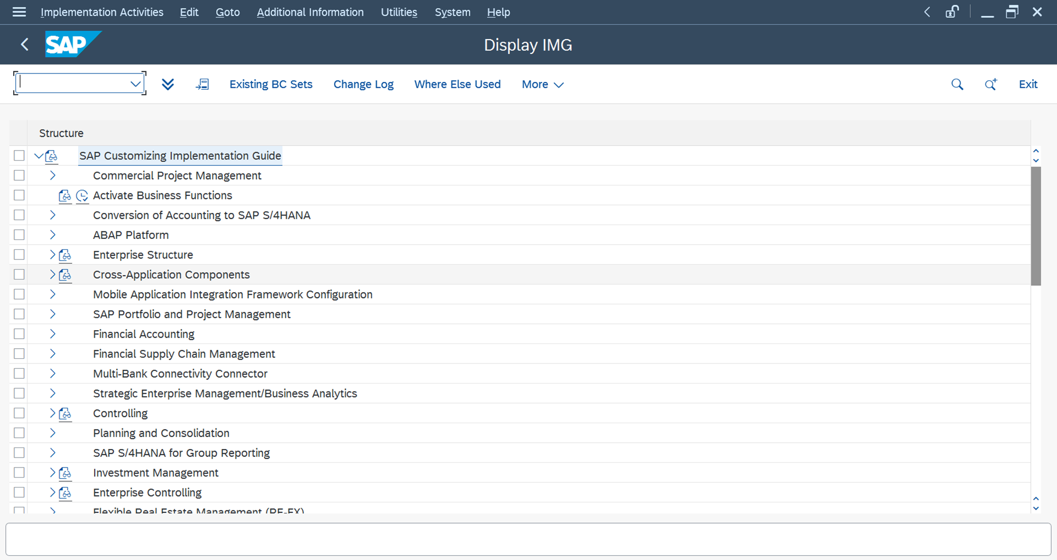
Learning is also Fun!
Activity:
We had interactive jam sessions and engaging story sessions where team members shared insights about their specialties. These sessions gave me a deeper understanding of my colleagues' expertise while building a collaborative learning environment.
A big relief came when we transitioned to hands-on practical sessions after several long days of theory. The practical work allowed us to apply what we had learned, making the experience more dynamic and engaging.

Slide 38
Summary
Quick Summary
This week’s learning focuses on key SAP functionalities including SAP Fiori User Experience, Tcode-SPRO for system customization, user management, vendor and customer master data management, the general ledger, and organizational units such as segments, profit centers, and cost centers. These areas are crucial for understanding how SAP streamlines operations, maintains financial accuracy, and supports strategic decision-making.
Importance of Topics for Upcoming Week
In the upcoming week, mastering SAP Fiori and Tcode-SPRO will help improve system usability and ensure efficient system configurations. Vendor and customer data management is essential for maintaining smooth supplier and client interactions, while the general ledger remains the backbone of financial operations. Understanding segments, profit centers, and cost centers will provide deeper insights into Shell's financial structure, aiding in performance analysis and cost management.
Connectivity of Topics from Current Week
The topics from this week are interconnected through the broader goal of operational efficiency and financial management within Shell. SAP Fiori and Tcode-SPRO support user-friendly interfaces and system configurations, which directly impact how well vendor and customer data, general ledgers, and organizational units (segments, profit centers, cost centers) are managed. These areas collectively help Shell optimize processes, maintain accurate financial reporting, and make data-driven business decisions.

Slide 39
Thank You

